Slide 1
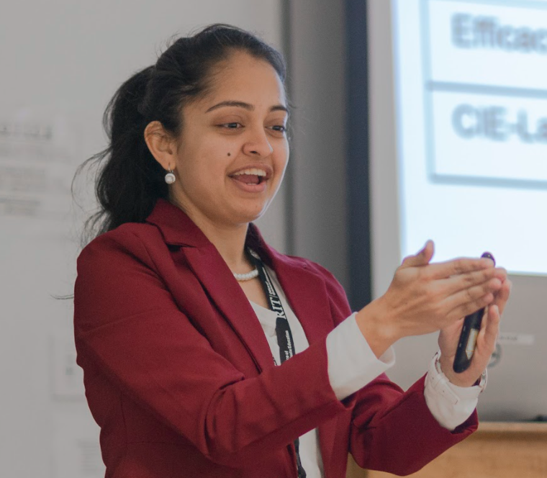

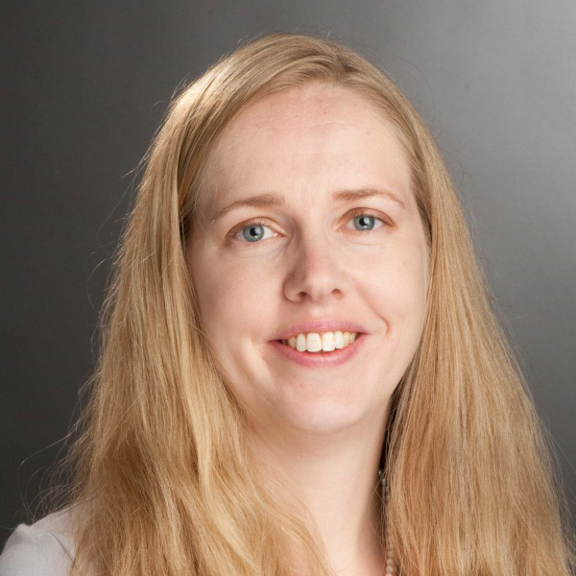
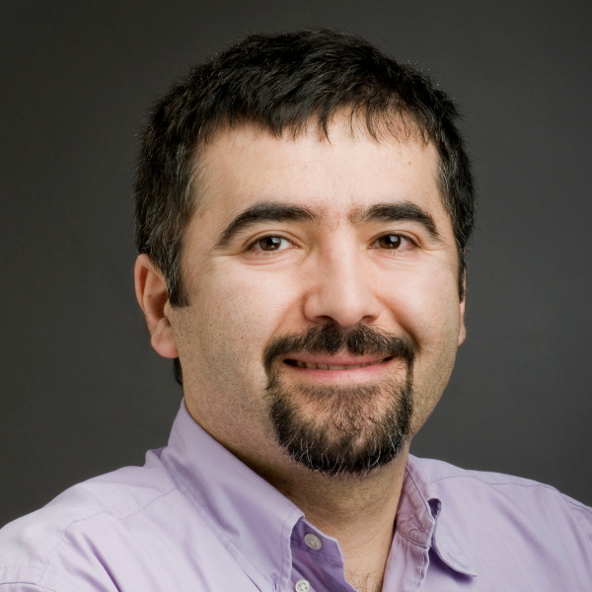
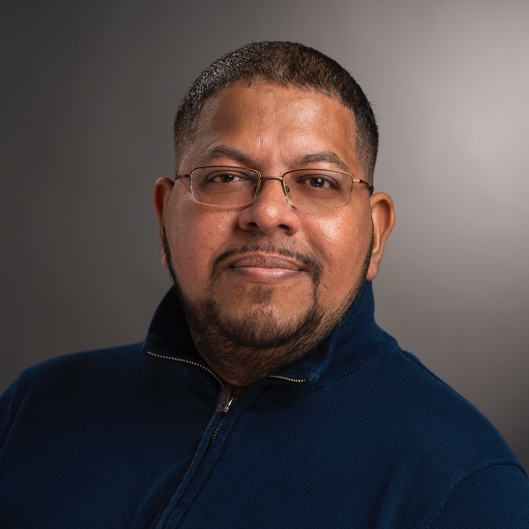
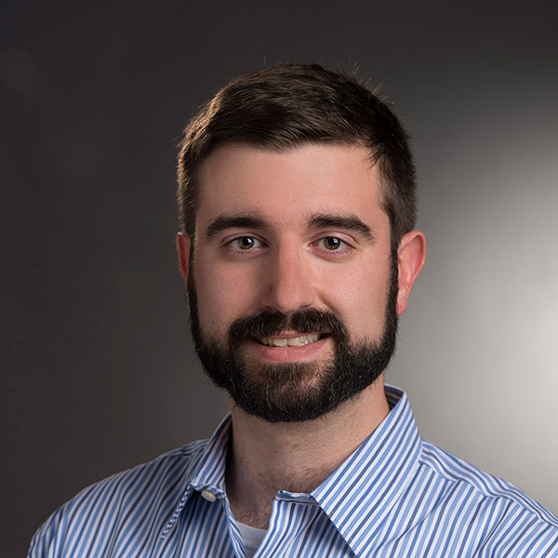
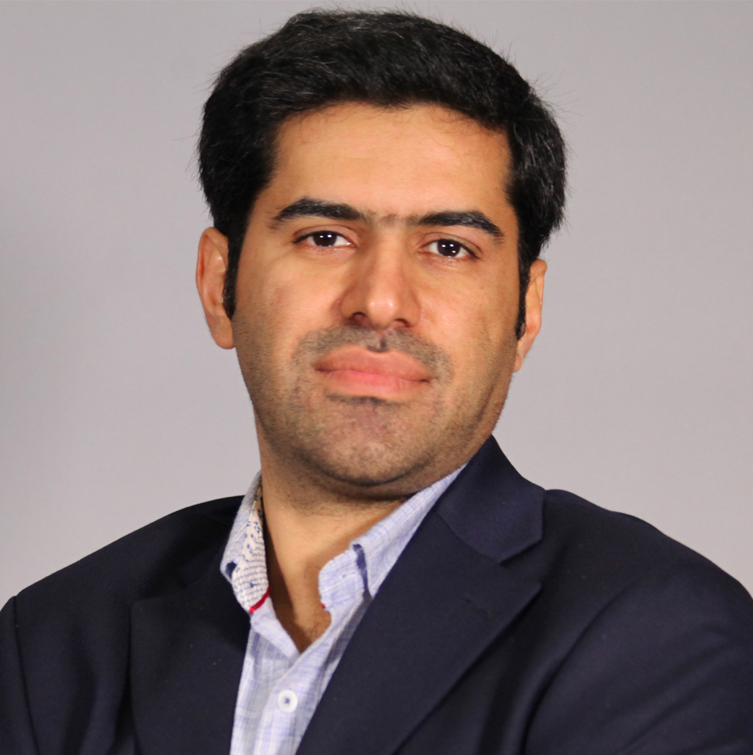

Wednesday Aug 23 (Day 1)
2023 AWARE-AI ONBOARDING awareainrt@rit.edu
Golisano Hall/GCI CYB 70-2780
9:00 - 9:30 a.m. Introductions CRT-NRT trainees and breakfast
9:30 - 11:30 a.m. Session I
11:30 - 12:00 p.m. Session II
12:00 - 12:45 p.m. Lunch with interactive recap of key orientation points with Dr. Alm
12:45 - 2:00 p.m. NRT faculty’s lab overview + lab resources talks
2:00 - 2:30 p.m. Session III
Orientation by NRT Director
Dr. Cecilia Alm, PI and AWARE-AI Director
2:30 - 3:45 p.m. Research to Mentoring Bridge: AI Software
3:45 - 4:00 p.m. Networking coffee mingle in CYB-1710-1730
4:00 - 5:00 p.m. Session IV Senior Scientist Plenary Talk in CYB-1710-30 Global Cybersecurity Center Using Large Language Models to Build Explainable Classifiers Dr. Chris Callison-Burch Associate Professor University of Pennsylvania AI2 Research Sabbatical Introduced by Dr. Cecilia Alm
Internships overview and completion of internships form (bring CV and cover letter)
Dr. Ferat Sahin, Co-PI
Dr. Bailey
Dr. Ororbia
Dr. Alm
Dr. Baheri
Pre-Law
Lab rotations overview and completion of lab rotations form
Dr. Alex Ororbia, Co-PI; Dr. Cecilia Alm, PI
This material is based upon work supported by the National Science Foundation under Award No. DGE-2125362. Any opinions, findings, and conclusions or recommendations expressed in this material are those of the author(s) and do not necessarily reflect the views of the National Science Foundation.

Slide 2

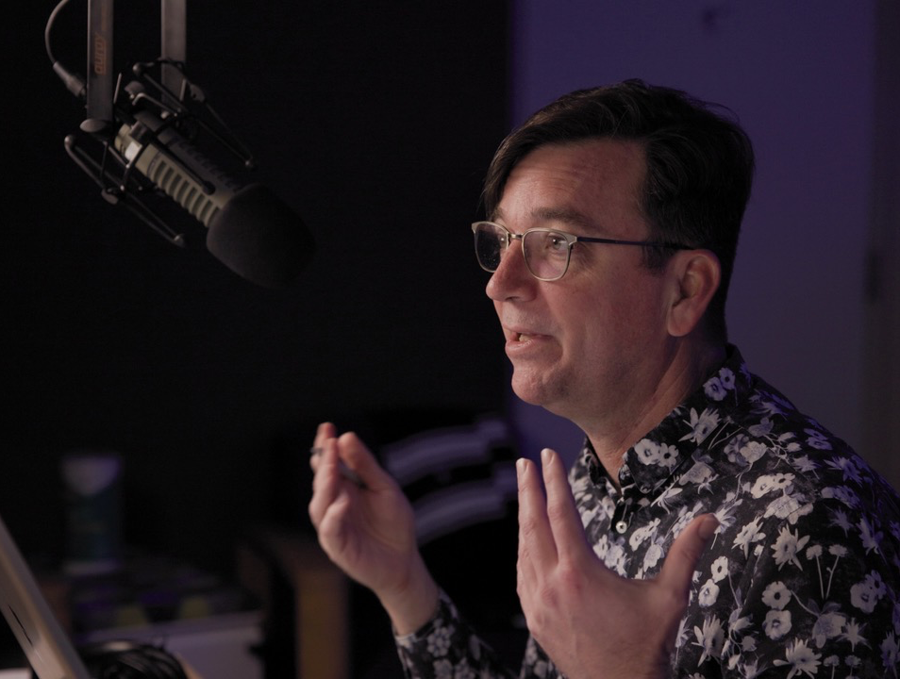
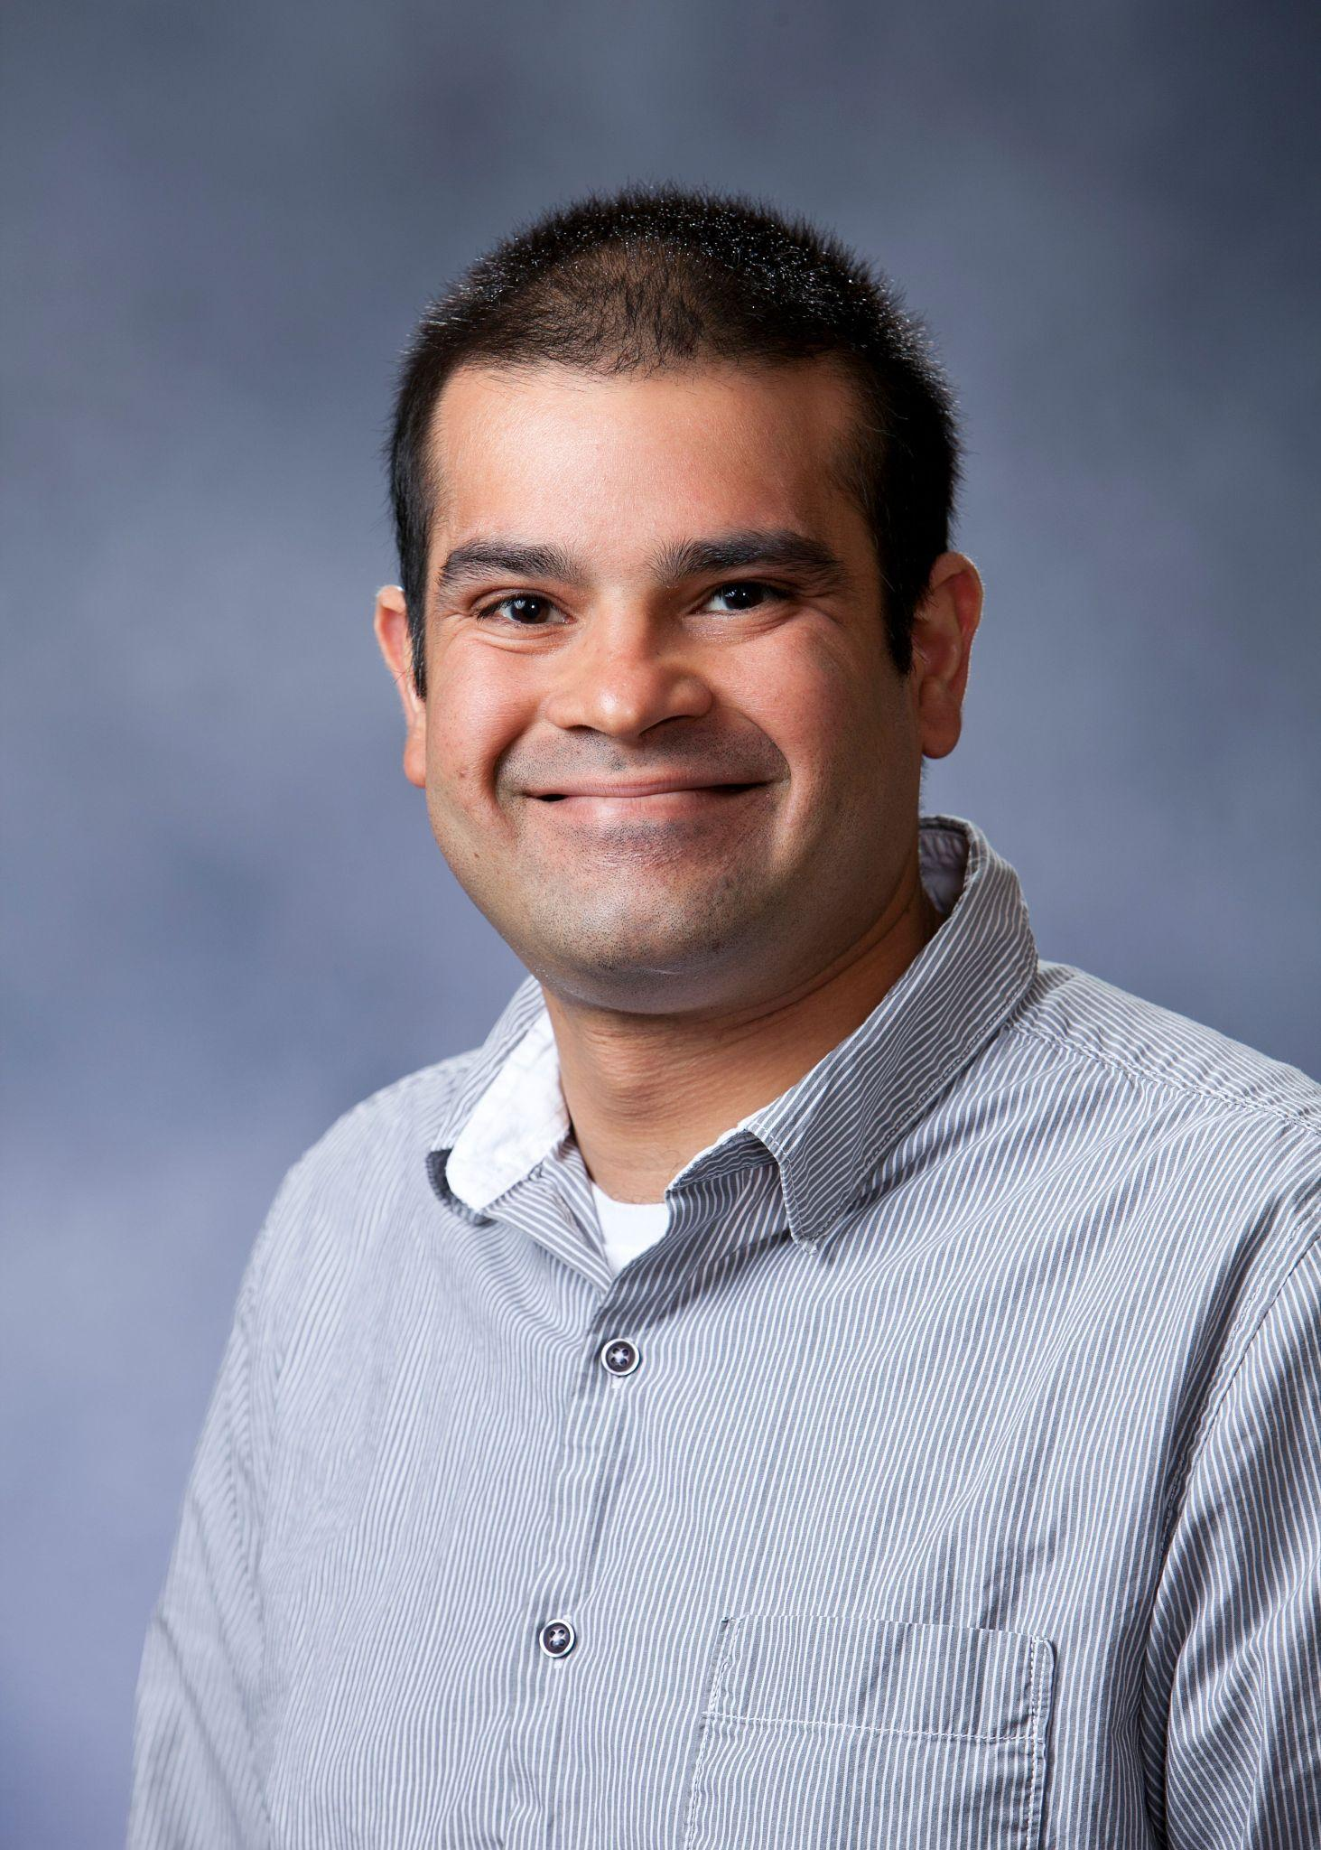
Using Large Language Models to Build Explainable Classifiers
From Autonomy to Synergy: Envisioning Next Generation Human-AI Partnerships
Chris Callison-Burch
University of Pennsylvania
Philadelphia, PA, USA
ccb@upenn.edu
ABSTRACT: This presentation discusses research on using large language models (LLMs) to build explainable classifiers. It will show off work from my PhD students and collaborators on several recent research directions:
Image classification with explainable features (arxiv.org/abs/2211.11158)
Text classification with explainable features (work in progress)
The importance of faithfulness in explanations (arxiv.org/abs/2209.11326)
A faithful "chain of thought" LLM reasoner that produces code in its explanations (arxiv.org/abs/2301.13379)
The talk will cover joint work with: Adam Stein, Ajay Patel, Ansh Kothary, Artemis Panagopoulou, Daniel Jin, Delip Rao, Eric Wong, Harry Li Zhang, Kathleen McKeown, Marianna Apidianaki, Mark Yatskar, Shenghao Zhou, Shreya Havaldar, Veronica Qing Lyu, Yue Yang, and others.
BIO: Chris Callison-Burch is an associate professor of Computer and Information Science at the University of Pennsylvania. His course on Artificial Intelligence has one of the highest enrollments at the university with 500 students taking the class each Fall. He is best known for his research into statistical machine translation, paraphrasing and crowdsourcing. His current research is focused on applications of large language models to long-standing challenge problems in artificial intelligence. His PhD students joke that now whenever they ask him anything his first response is “Have you tried GPT for that?” Prof Callison-Burch has more than 100 publications, which have been cited over 20,000 times. He is a Sloan Research Fellow, and he has received faculty research awards from Google, Microsoft, Amazon, Facebook, and Roblox, in addition to funding from DARPA, IARPA, and the NSF.
Wednesday August 23 at 4:00 p.m. ET in CYB 070 1710-1730

Slide 3
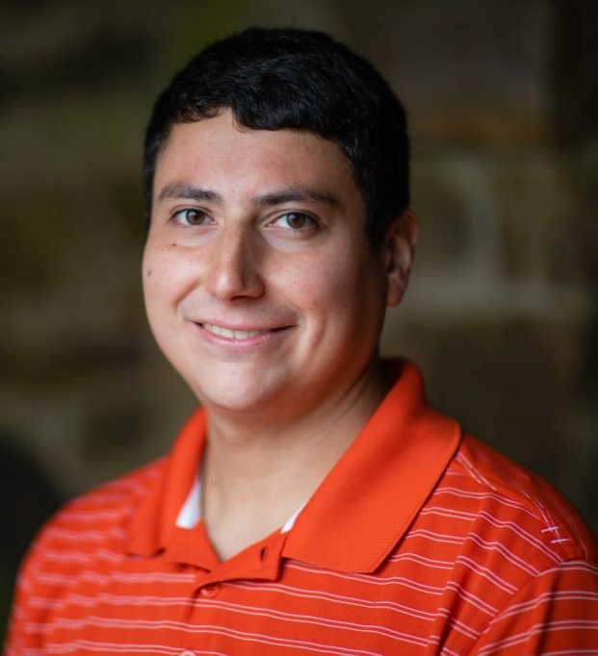
Providing Privacy for Eye-Tracking Data with Applications in XR
From Autonomy to Synergy: Envisioning Next Generation Human-AI Partnerships
Brendan David-John
Virginia Tech
Blacksburg, VA, USA
bmdj@cs.vt.edu
ABSTRACT: Eye-tracking sensors track where a user looks and are being increasingly integrated into mixed-reality devices. Although critical interactions are being enabled via ML models on sensor data, there are significant possibilities for violating user security and privacy expectations. There are appreciable privacy risks of eye-tracking data, including unique user identification. Biometric re-identification could allow cross-app identification that connects a user’s personal ID with their work ID without needing their consent, for example. Solutions are presented that address concerns related to the leaking of biometric features through eye-tracking data streams. Privacy mechanisms are introduced to reduce the risk of identification with formal guarantees while still enabling ML applications of released eye-tracking data streams. Gaze data streams can thus be made private while still allowing for applications key to the future of mixed-reality technology, such as applying deep gaze prediction models for foveated rendering, and models for activity or document type classification.
BIO: Dr. Brendan David-John is an Assistant Professor of Computer Science at Virginia Tech. David-John was the first Native male to graduate with a doctorate in Computer Science from the University of Florida in 2022, and received his BS and MS from the Rochester Institute of Technology in 2017. He is from Salamanca NY, which is located on the Allegany reservation of the Seneca Nation of Indians. His personal goals include increasing the representation of Native Americans in STEM and higher education, specifically in computing. He is a proud member of the American Indian Science & Engineering Society and has been a Sequoyah Fellow since 2013. His research interests include virtual reality and eye tracking, with a primary focus on privacy and security for the future of virtual and mixed reality.
Thursday August 24 at 11:00 a.m. ET in CYB 070-1750

Slide 4
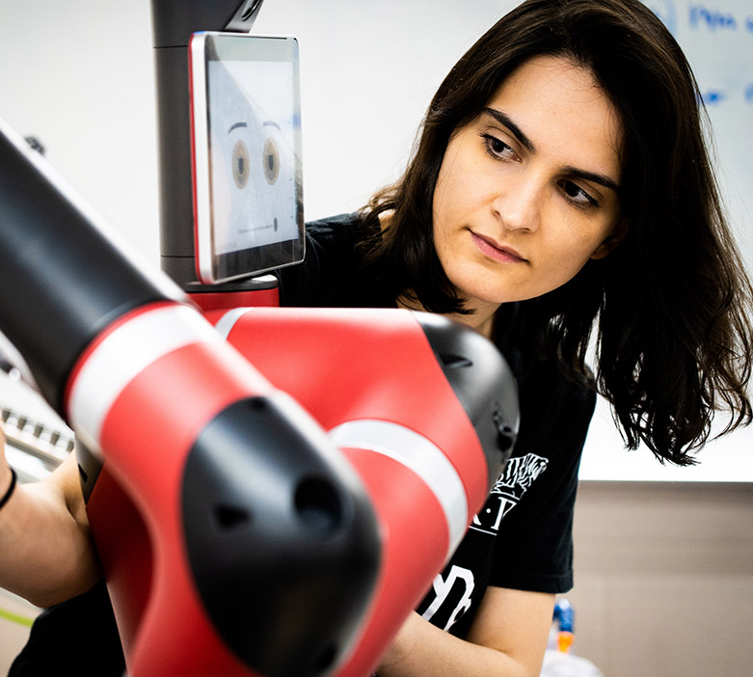
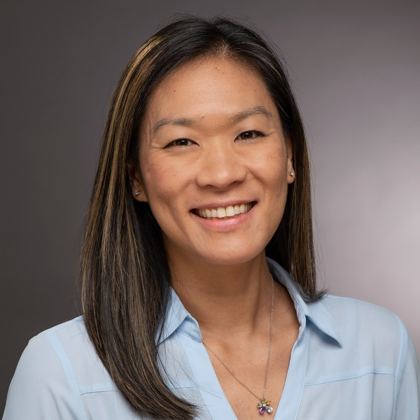
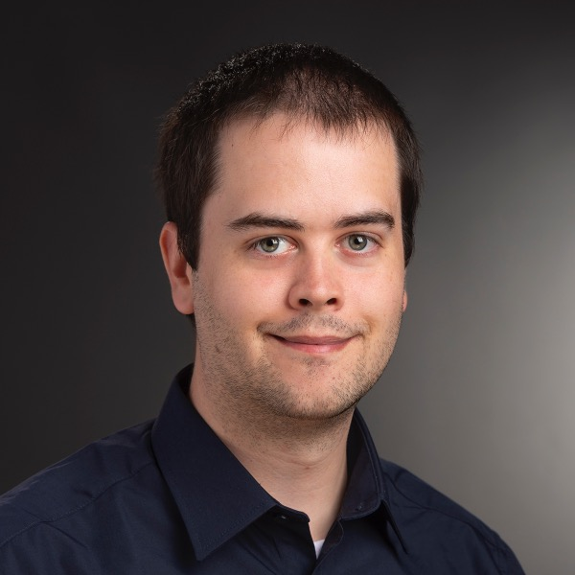
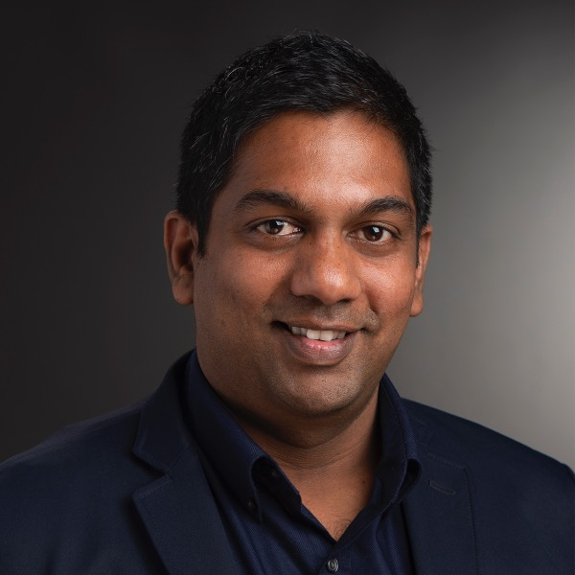
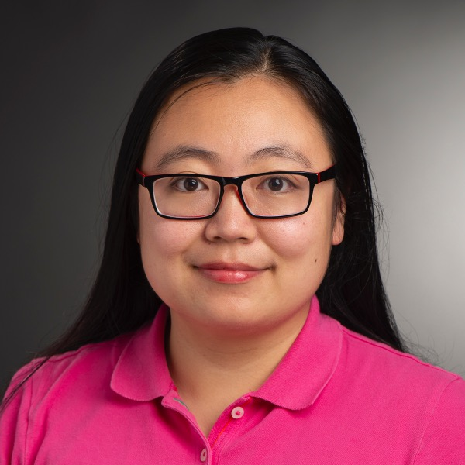
12:00 - 1:00 p.m. Debriefing lunch break with Dr. Sahin
1:00 - 2:00 p.m. Research to Mentoring Bridge: HCI for AI
Research to Mentoring Bridge: AI Hardware
2:00 - 2:45 p.m.
2:45 - 3:30 p.m. Coffee and interaction with plenary speaker
3:30 - 4:15 p.m. Session VII
4:15 - 5:30 p.m. NRT Trainees’ breakout groups
by research tracks for planning and final research plan/lightning talk preparations
Dr. Shinohara
Dr. Tigwell
Dr. Peiris
unexpected.
Dr. Sahin
Thursday Aug 24 (Day 2)
Dr. Yan
Golisano Hall/GCI CYB 70-2780
9:00 - 9:30 a.m. Pre-meeting session by Dr. Shinohara:
MSI visits and completion of visit form (bring CV) Participants: Liya, Mahsa, Marzieh, Michael, Rodney, Will
9:30 - 10:15 a.m. Breakfast: Trainee Council overview with Director
10:15 - 11:00 a.m. Session V
11:00 - 12:00 p.m. Session VI
Evaluator’s pre-survey
Introduction by Ferat Sahin
Seed funding award competition
Esa Rantanen, Seed funding chair Prior winner Emily Kuang, PhD trainee
Links:
AWARE-AI Twitter https://twitter.com/AWAREAINRT
AWARE-AI Instagram https://www.instagram.com/rit_awareai
Lab rotations form https://forms.gle/9zNWo6gPRcwqSRoC8
Internship form https://forms.gle/V2biDMp5Q2JPnX5K9
MSI form https://forms.gle/vg3vnwjyw2eRDdHs8
Pre-tenure Scientist Plenary Talk in CYB-1750
Cyber Range, Global Cybersecurity Center
Providing Privacy for Eye-Tracking Data with Applications in XR Dr. Brendan David-John Assistant Professor, Virginia Tech Introduced by Dr. Kristen Shinohara

Slide 5
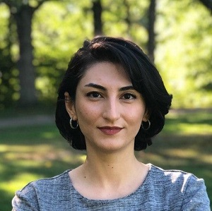
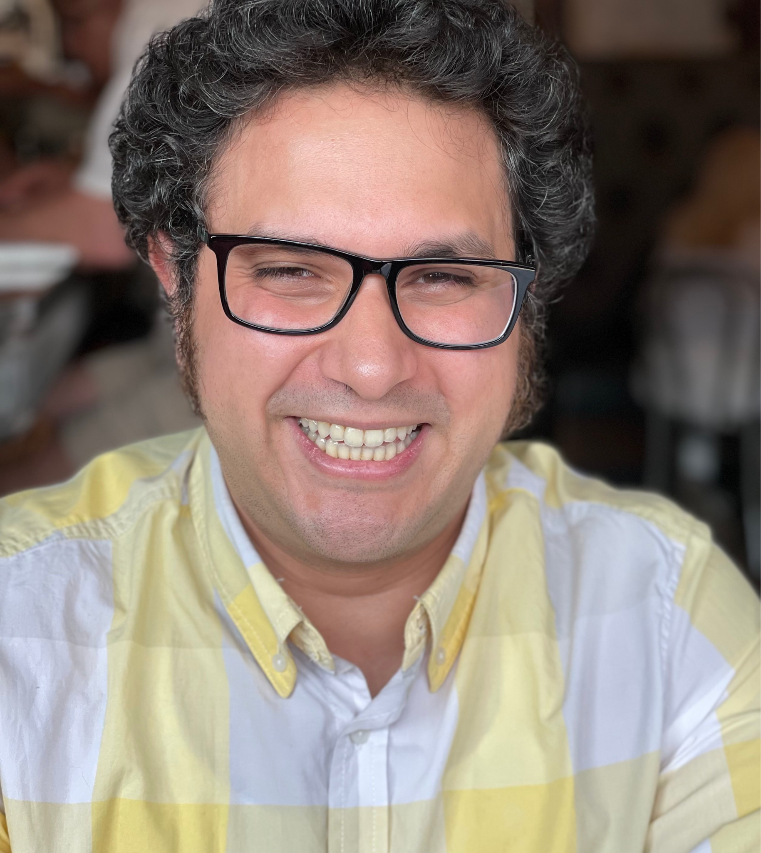
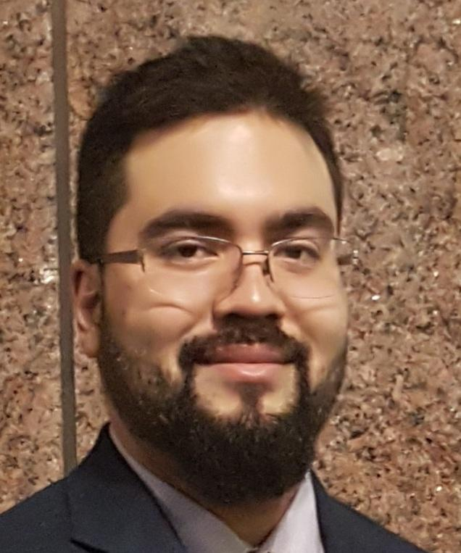
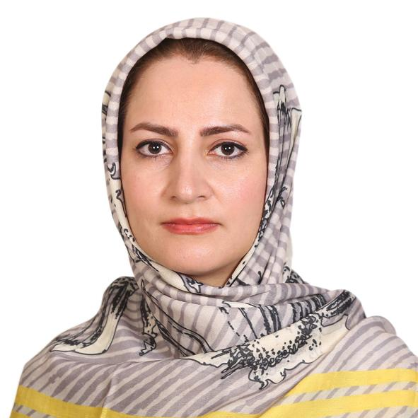
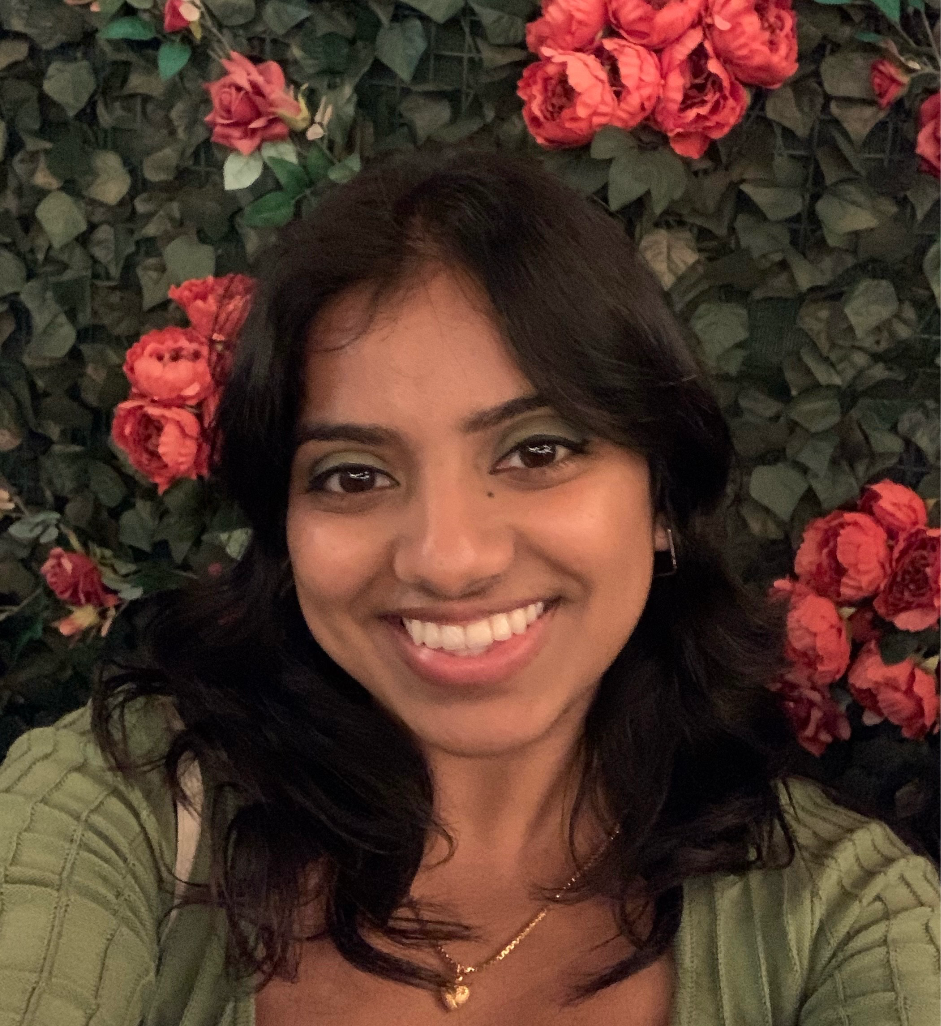
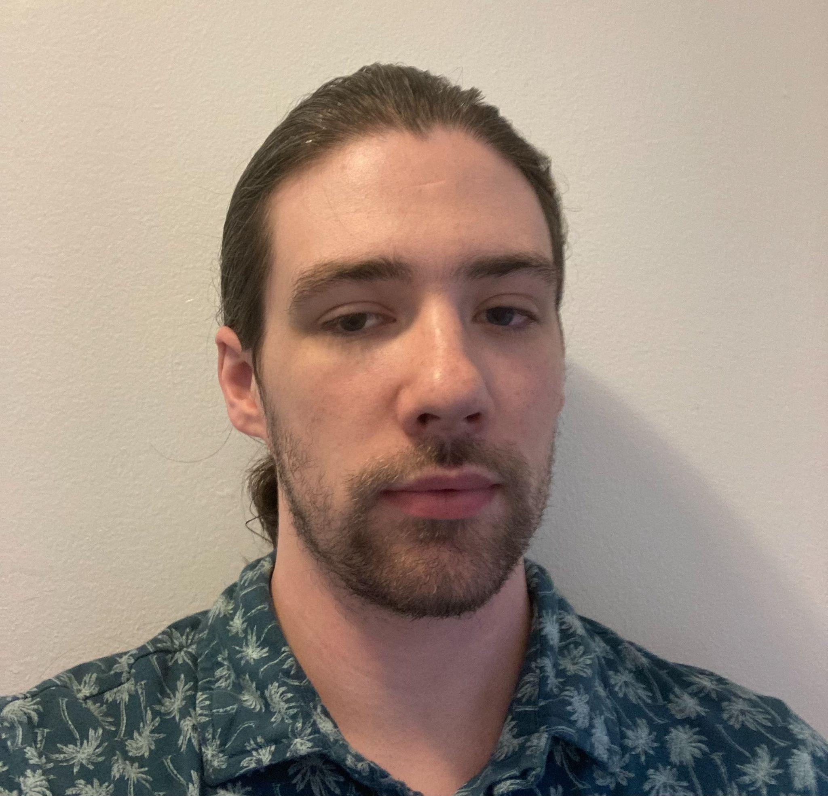
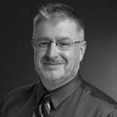
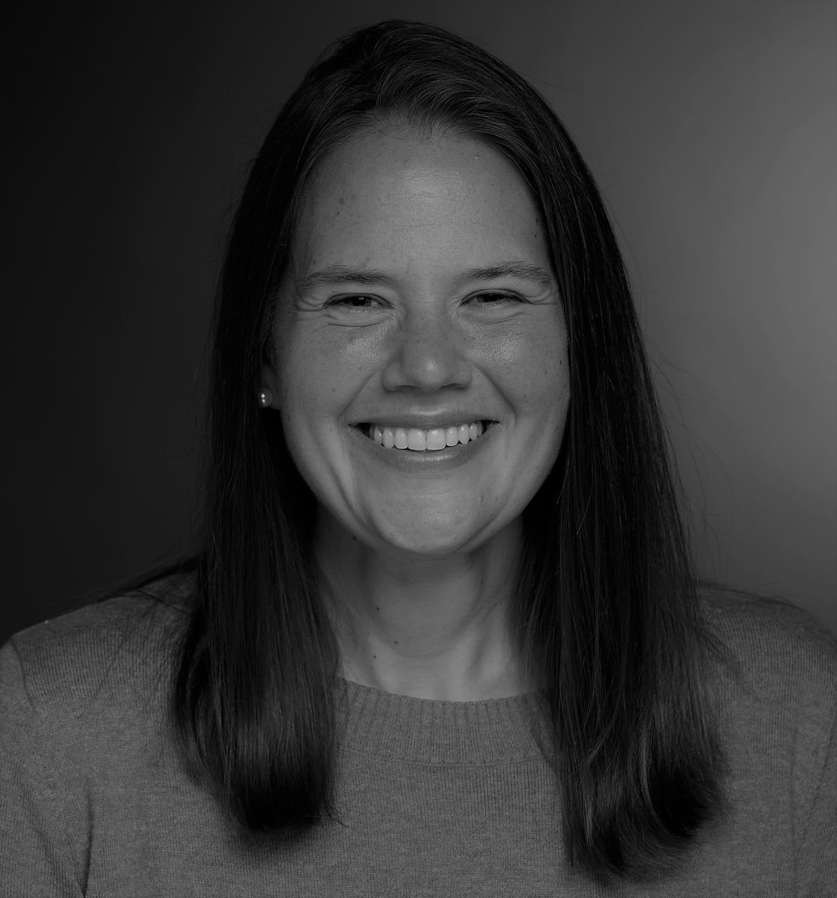
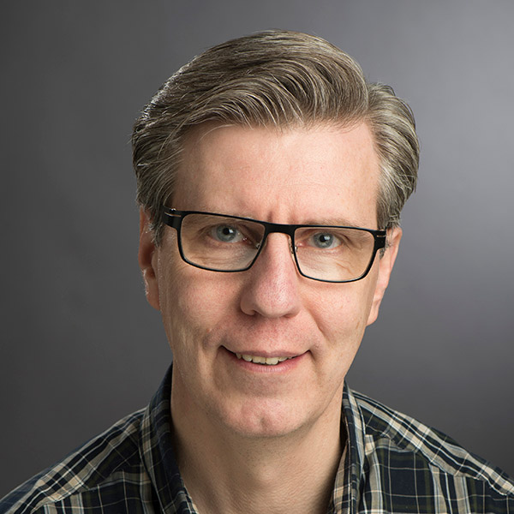
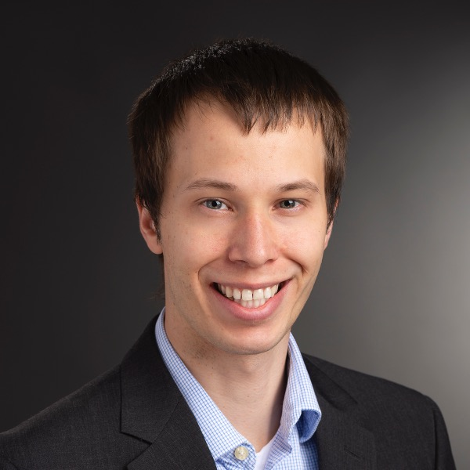
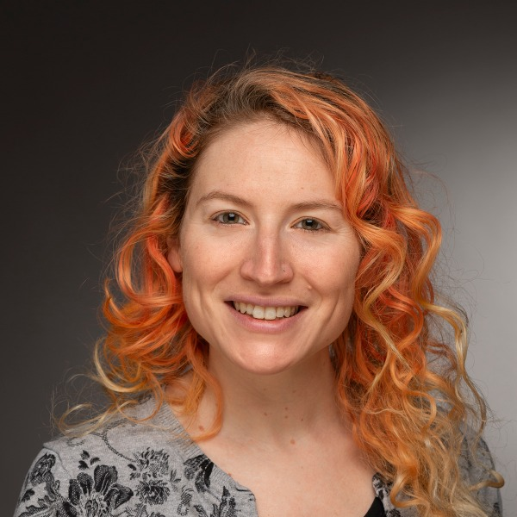
12:00 - 1:00 p.m. Peer-2-Peer Program Lunch with peer mentor interactions Chair: Dr. Ferat Sahin
1:00 - 2:45 p.m. Session X
Chair: Dr. Esa Rantanen
NRT Trainees: Research plan talks (12 min + 3 min Q&A):
2:45 - 3:30 p.m. Coffee celebration of AWARE-AI alumni
3:30 - 5:00 p.m. Session XI Incoming NRT Trainees: Lightning talks (5 min each + Q&A) Chair: Dr. Kristen Shinohara
5:00 p.m. Concluding remarks by Dr. Cecilia Alm
unexpected.
T1: M. Mozaffari
T1: M. Peechatt
T2: R. Sanchez
Friday Aug 25 (Day 3)
Golisano Hall/GCI CYB 1710-1720
8:45 - 9:30 a.m. Breakfast and virtual interaction with Dr. Callison Burch
9:30 - 10:30 a.m. Session VIII
10:30 - 11:15 a.m. Research to Mentoring Bridge: Cognitive Models for AI
11:15 - 12:00 p.m. Session IX
Conflict resolution in research teams
Joe Johnston/Ashley Meyer, Ombuds Office
Chair: Dr. Esa Rantanen
T3: M. Shahbazi
T3: L. Thomas
T4: W. Gebhardt
Dr. Rantanen
Dr. Heard
Dr. Fitch
F. Hyder, G. Park, H. Hendy, M. Raziuddin Chowdhury, N. Sahar, R. Ramadass, R. Fayyazi, R. Sahay, Y. Wang
Workshop on professional communication: Setting Up LinkedIn, Google Scholar, and considerations for your professional website
Chairs and Faculty Respondents: Ferat Sahin, Esa Rantanen

